Slide 1
Phishing attacks
By
V.Sruthi

Slide 2
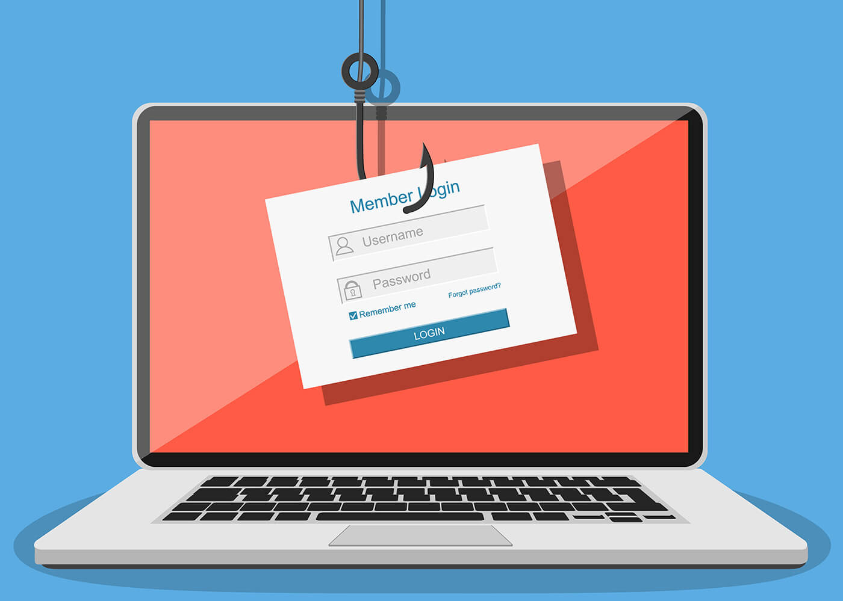
index
What is Phishing ?
Types of phishing attacks .
Recent new phishing attacks.
What are signs of phishing attacks?
Phishing prevention and mitigation

Slide 3
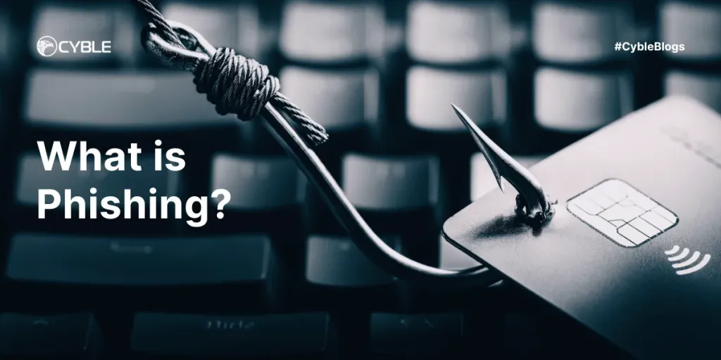
What is phishing ?
Phishing is a type of cyberattack that uses fraudulent emails, text messages, phone calls websites to trick people into sharing sensitive data, downloading malware to trick people into sharing sensitive data, downloading malware or otherwise exposing themselves to cybercrime.
Phishing attacks are a form of social engineering. Unlike other cyberattacks that directly target networks and resources, social engineering attacks use human error, fake stories and pressure tactics to manipulate victims into unintentionally harming themselves or their organizations.

Slide 4
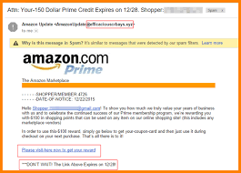
Types of phishing attacks
Bulk email phishing
In bulk email phishing, scammers indiscriminately send spam emails to as many people as possible, hoping that a fraction of the targets fall for the attack.
The body of the email instructs the recipient to take a seemingly reasonable action that results in divulging sensitive information or downloading malware. For example, a phishing link might read, "Click here to update your profile." When the victim clicks that malicious link, it takes them to a fake website that steals their login credentials.

Slide 5
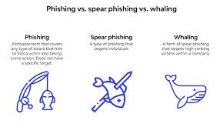
Spear phishing
Spear phishing is a targeted phishing attack on a specific individual. The target is usually someone with privileged access to sensitive data or special authority that the scammer can exploit.
A spear phisher studies their target to gather the information they need to pose as someone the target trusts, such as a friend, boss, coworker, vendor or financial institution. Social media and professional networking sites—where people publicly congratulate coworkers, endorse vendors and tend to overshare—are rich sources of information for spear phishing research.

Slide 6
Business email compromise (BEC)
BEC is a class of spear phishing attacks that attempt to steal money or valuable information for example, trade secrets, customer data or financial information from a business or other organization.
BEC attacks can take several forms. Two of the most common include:
CEO fraud: The scammer impersonates a C-level executive, often by hijacking the executive's email account. The scammer sends a message to a lower-level employee instructing them to transfer funds to a fraudulent account, make a purchase from a fraudulent vendor or send files to an unauthorized party.
Email account compromise (EAC): The scammer compromises a lower-level employee's email account, such as the account of a manager in finance, sales or research and development. The scammer uses the account to send fraudulent invoices to vendors, instruct other employees to make fraudulent payments or request access to confidential data.

Slide 7
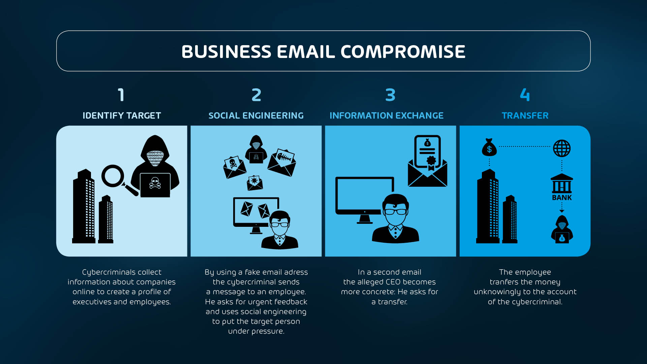

Slide 8
Smishing
SMS phishing, or smishing, uses fake text messages to trick targets. Scammers commonly pose as the victim's wireless provider, sending a text that offers a "free gift" or asks the user to update their credit card information. Some smishers pose as the US Postal Service or another shipping company. They send texts that tell victims they must pay a fee to receive a package they ordered.
Vishing
Voice phishing, or vishing, is phishing by phone call. Scammers often use caller ID spoofing to make their calls appear to come from legitimate organizations or local phone numbers. Vishing calls typically scare recipients with warnings of credit card processing problems, overdue payments or trouble with the law. Recipients end up providing sensitive data or money to the cybercriminals to "resolve" their issues.

Slide 9
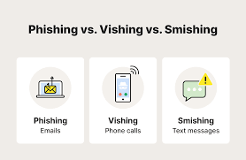

Slide 10
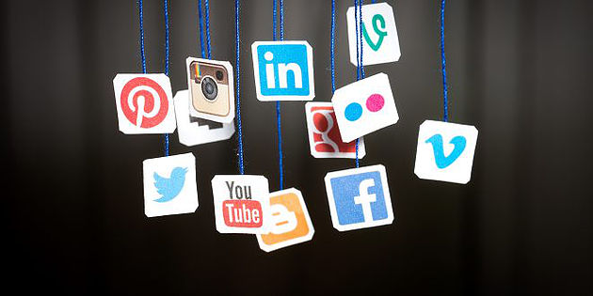
Social media phishing
Social media phishing employs social media platforms to trick people. Scammers use the platforms' built-in messaging capabilities for example, Facebook Messenger, LinkedIn InMail and X (formerly Twitter) DMs the same ways they use email and text messaging.
Scammers often pose as users who need the target's help logging in to their account or winning a contest. They use this ruse to steal the target's login credentials and take over their account on the platform. These attacks can be especially costly to victims who use the same passwords across multiple accounts, an all-too-common practice.

Slide 11
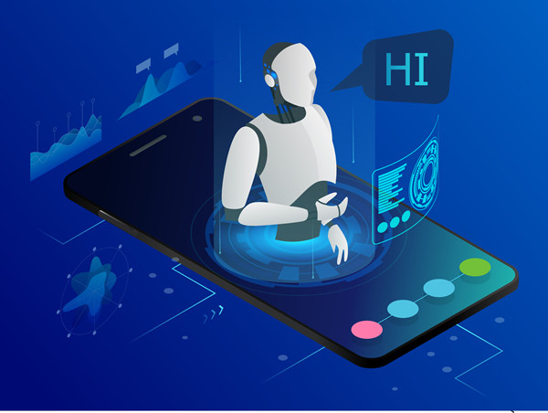
New phishing techniques
AI phishing
AI phishing uses generative artificial intelligence (AI) tools to create phishing messages. These tools can generate tailored emails and text messages that lack spelling errors, grammatical inconsistencies and other common red flags of phishing attempts.
Scammers also use image generators and voice synthesizers to add further credibility to their schemes. For example, in 2019, attackers used AI to clone the voice of an energy company CEO and scam a bank manager out of USD 243,000

Slide 12
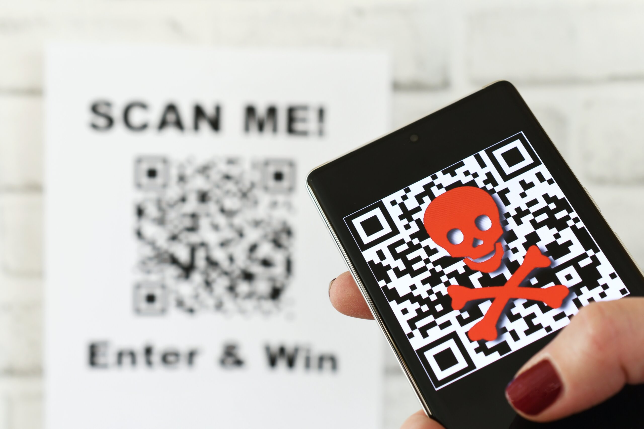
Quishing
Quishing uses fake QR codes embedded in emails and text messages or posted in the real world. Quishing allows hackers to hide malicious websites and software in plain sight
Hybrid vishing
Hybrid vishing attacks combine voice phishing with other methods to evade spam filters and gain victims' trust.For example, a scammer might send an email purporting to come from the IRS. This email tells the target that there is a problem with their tax return. To resolve the issue, the target must call a phone number provided in the email, which connects them directly to the scammer.

Slide 13
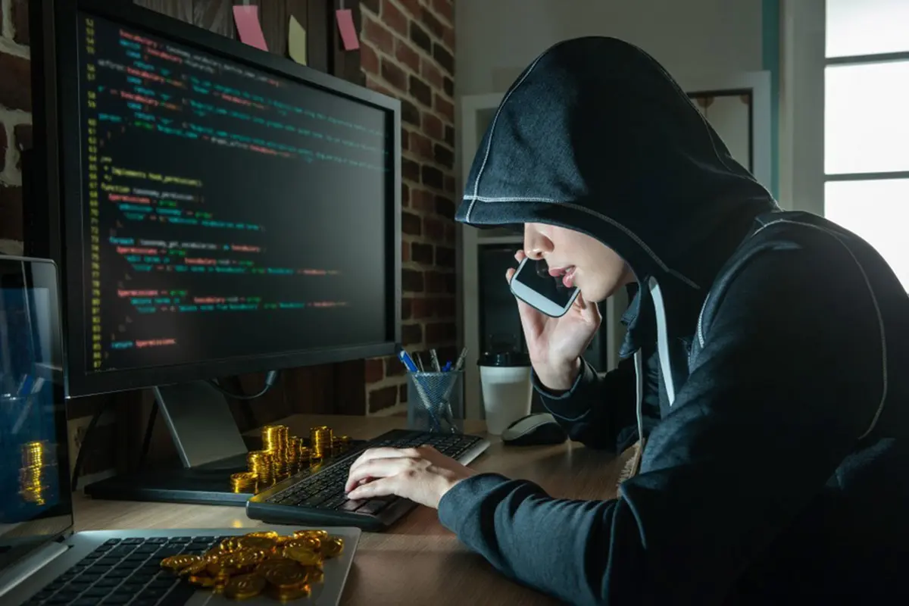
What are the signs of a phishing attack?
Details can vary from scam to scam, but there are some common signs that indicate a message might be a phishing attempt. These signs include:
Strong emotions and pressure tactics
Phishing scams try to make victims feel a sense of urgency so that they act quickly without thinking. Scammers often do this by invoking strong emotions like fear, greed and curiosity.

Slide 14
Requests for money or sensitive information
Phishing scams typically ask for one of two things: money or data. Unsolicited or unexpected requests for payment or personal information can be signs of phishing attacks.
Poor spelling and grammar
Many phishing gangs operate internationally, which means they often write phishing messages in languages they do not speak fluently. Therefore, many phishing attempts contain grammatical errors and inconsistencies.
Generic messaging
Messages from legitimate brands often contain specific details. A vague message such as "There is an issue with your account" with no further details is a red flag.

Slide 15
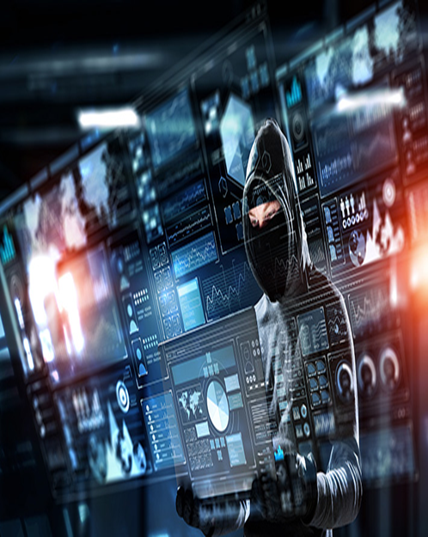
Fake URLs and email addresses
Scammers often use URLs and email addresses that appear legitimate at first glance. For example, an email from "admin@rnicrosoft.com" might seem safe, but look again. The "m" in "Microsoft" is actually an "r" and an "n."
Other signs
Scammers might send files and attachments the target did not request for and does not expect. They might use images of text instead of actual text in messages and web pages to avoid spam filters.

Slide 16
Phishing prevention and mitigation
Security awareness training and organizational policies
Because phishing scams target people, employees are often an organization's first and last line of defense against these attacks. Organizations can teach users how to recognize the signs of phishing attempts and respond to suspicious emails and text messages. This can include giving employees easy ways to report phishing attempts to the IT or security team.
Organizations can also establish policies and practices that make it harder for phishers to succeed.

Slide 17
Antiphishing tools and technology
Spam filters and email security software use data on existing phishing scams and machine learning algorithms to identify phishing emails and other spam messages. The scams and spam are then moved to a separate folder, where malicious links and code are eradicated.
Antivirus and antimalware software can detect and neutralize malicious files or code carried by phishing emails.
Multifactor authentication can prevent hackers from taking over user accounts. Phishers can steal passwords, but they have a much harder time stealing a second factor like a fingerprint scan or one-time passcode

Slide 18
Endpoint security tools like endpoint detection and response (EDR) and unified endpoint management (UEM) solutions can use artificial intelligence (AI) and advanced analytics to intercept phishing attempts and block malware
Web filters prevent users from visiting known malicious websites and display alerts whenever users visit suspicious pages. These tools can help mitigate damage if a user clicks a phishing link.
Enterprise cybersecurity solutions, such as security orchestration, automation and response (SOAR) and security information and event management (SIEM) platforms, use AI and automation to detect and respond to anomalous activity. These solutions can help stop phishers who are attempting to install malware or take over accounts.

Slide 19
Tools for detecting phishing
Email Header Analysis:
MXToolbox: Detects phishing attempts, spam, malware, and impersonation scams. https://mxtoolbox.com/
Google Message Header: Provides insights into email headers. https://toolbox.googleapps.com/apps/messageheader/
MailHeader: Analyzes email headers for security threats. Analyze my mail header
Azure Header Analyzer: Assesses email header information. Message Header Analyzer (mha.azurewebsites.net)

Slide 20
URL / IP Reputation Check:
Virustotal: Scans URLs and IPs for threats. https://www.virustotal.com/gui/home/search
Talosintelligence: Identifies malicious domains and IPs. https://www.talosintelligence.com/
AbuseIPdb: Checks IP reputation. https://www.abuseipdb.com/
visualization Tools:
• URLScan: Visualizes malicious URLs without visiting them. https://urlscan.io/
File / Attachment / Malware Analysis:
Anyrun Sandboxing: Executes files in a sandboxed environment. https://any.run/
Hybrid-Analysis Sandboxing: Provides dynamic analysis of files. https://lnkd.in/gaRGY8kB

Slide 21
Who.is tool for analysis https://who.is/
Phish Tool: Collects artifacts from phishing emails. https://www.phishtool.com/
Phishunt: https://phishunt.io/
Remember to stay vigilant and use these tools to protect yourself and your organization from phishing threats.

Slide 22
THANKyou

